Slide 1
B.R.A.M. Disaster Management App
Empowering communities with real-time disaster reporting, alerts, and self-rescue guidance.

Slide 2
PURPOSE
The B.R.A.M. app provides residents of Buea and surrounding areas with tools to prepare for and report disasters. It offers real-time alerts, disaster feeds, and safety tips via a user-friendly mobile interface designed with React Native.

Slide 3
Core app functionalities
Provides disaster reporting with media uploads, real-time alerts, user authentication and profile management, disaster feed browsing, and access to self-rescue tips

Slide 4

Loading Screen

Slide 5
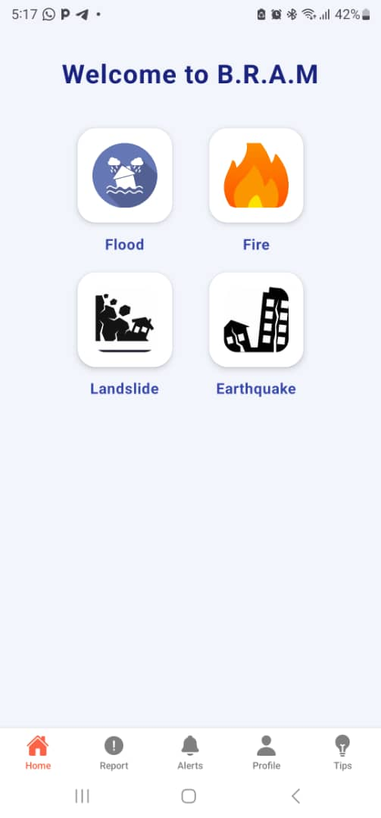
HOMEPAGE
The Homepage opens with a Welcome to B.R.A.M message and a icons of flood, Fire, Landslide, Earthquake that when click on the icon it takes the user to the Alert page, with the other navigation tabs at the bottom

Slide 6
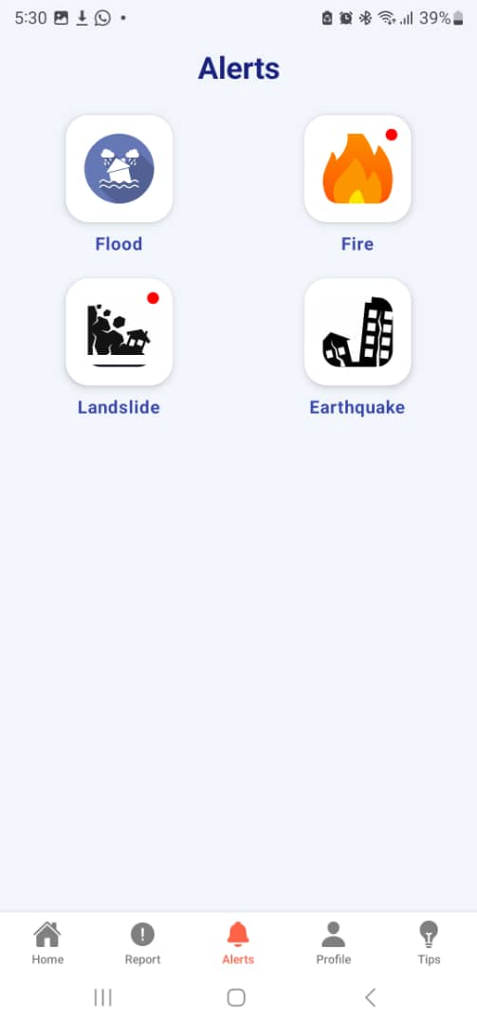
ALERT PAGE
The Alert Page has the same icon with the Home page but has notification dot on the icons

Slide 7
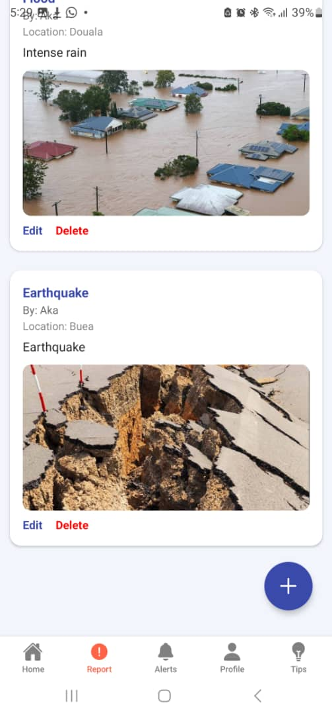
REPORT PAGE
In the report screen it shows all the recent reports locations and the account name that post them.
The Plus Icon us use to add disaster report

Slide 8
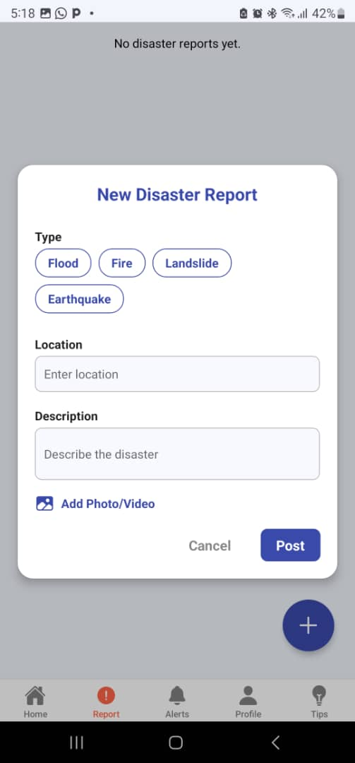
NEW DISASTER REPORT
Where a user can add new photo, videos and disaster report including the location and description

Slide 9
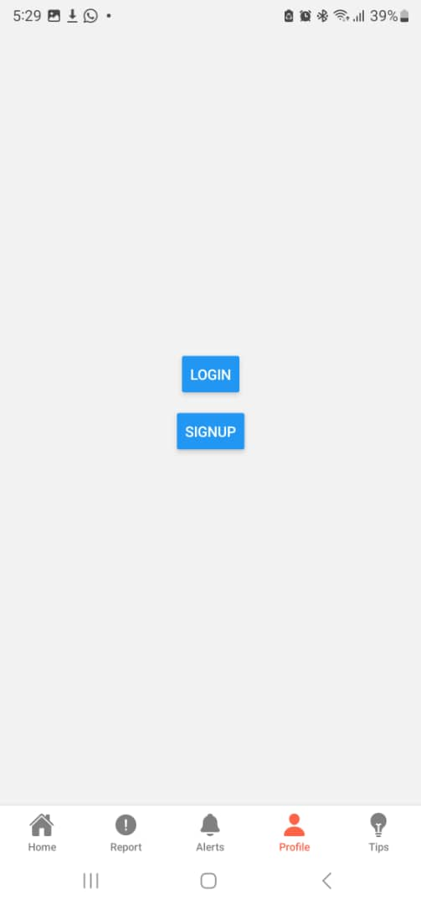
PROFILE PAGE
The Profile screen has a two main option Login and Signup uses that already have an account can login and users that want to create an account can signup

Slide 10
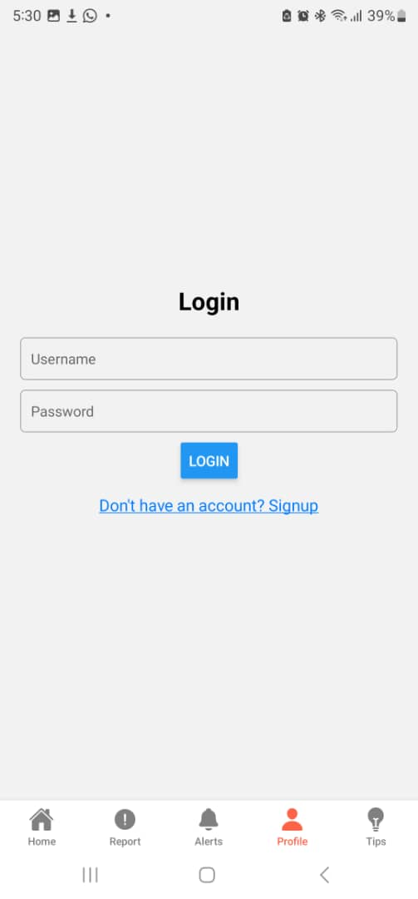
Login

Slide 11
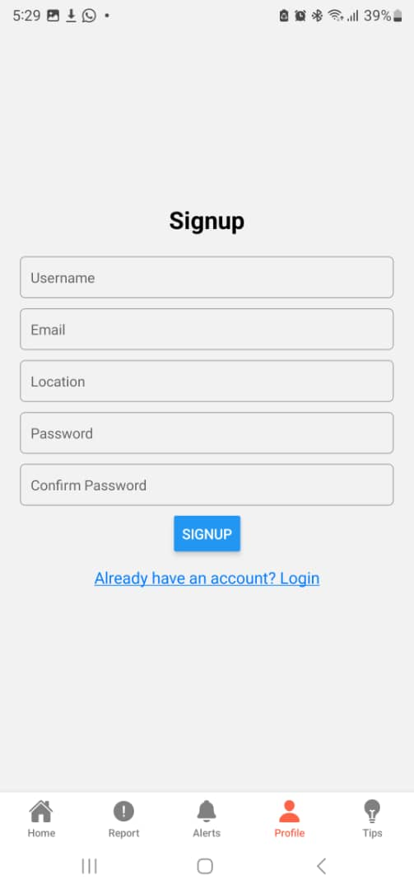
SIGNUP

Slide 12
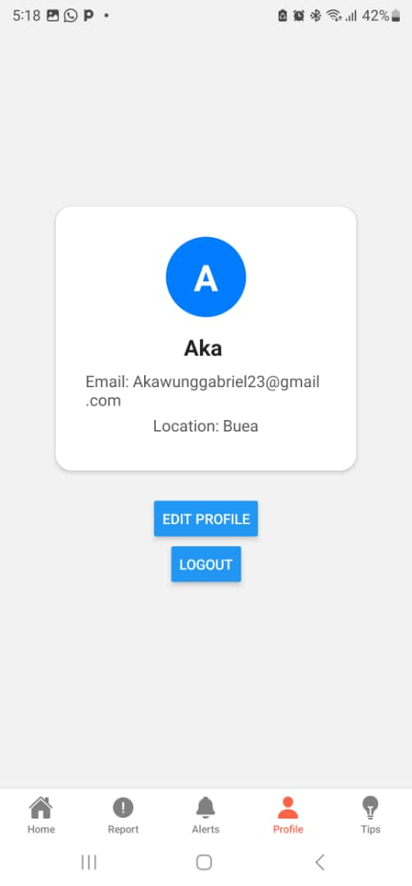
PROFILE
The profile screen after logging in the profile will look like this displaying the email, user name and location.
With option to edit profile and logout

Slide 13
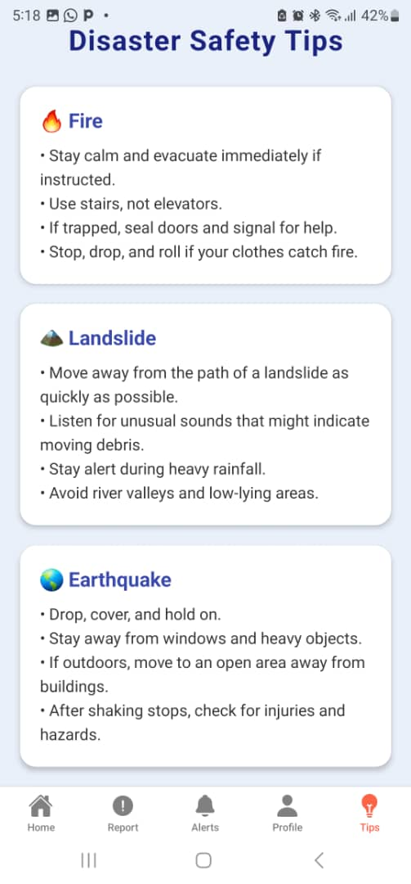
TIPS SCREEN
This screen help users to know what to do during disasters.

